Slide 1


Data 603: Platforms for Big Data Processing
Final Project: Chicago Traffic Crash Analysis and Injury Prediction
Sunil Kumar Medara Mounika Poreddi

Slide 2
Agenda
1. Problem Statement
2. Project Overview
3. Dataset Overview
4. Exploratory Data Analysis
5. Feature Engineering
6. PySpark ML algorithms and Metrics
7. Conclusion
8. Recommendations
9. References

Slide 3
Problem Statement
In the City of Chicago, traffic crashes pose a significant challenge to public safety, efficient traffic management, and the overall well-being of the city’s residents and visitors. Despite the availability of extensive traffic crash data, there is a lack of effective tools to analyze, understand, and predict these incidents. This gap hinders the ability of city authorities, policymakers, and traffic management teams to make informed decisions, develop proactive safety measures, and implement strategic interventions.

Slide 4
Project Overview:
Main Objective: Leverage PySpark for comprehensive data cleaning, exploration, and visualization, followed by predictive analysis using Spark ML.
Scope and Focus: Focused on predicting injury severity in traffic crashes in Chicago through detailed data analysis.
Tools and Techniques: Exploratory Data Analysis (EDA) with PySpark: Employing EDA techniques to uncover patterns, relationships, and insights in traffic crash data. This includes analyzing:
Crash frequencies per hour and per week.
Impact of weather conditions on crash occurrences.
Machine Learning (ML) with Spark ML: Implementing Spark ML to develop models for predicting injury severity, leveraging machine learning capability to learn from data patterns and make informed predictions.

Slide 5
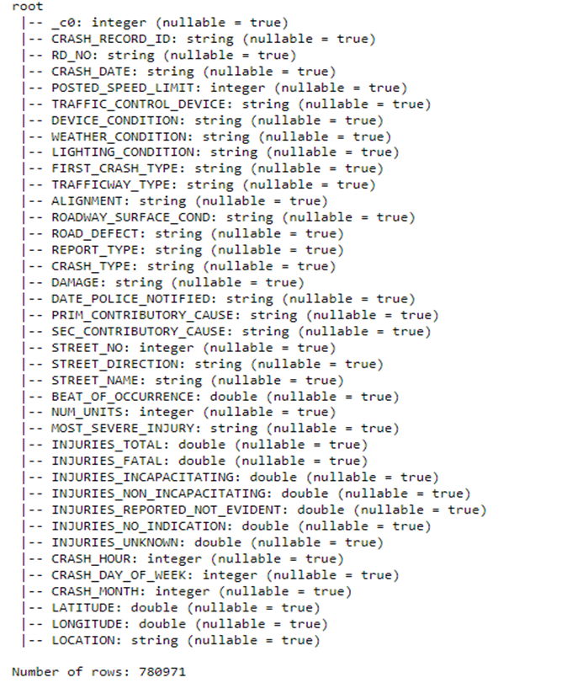
Dataset Overview
Data Source: https://data.cityofchicago.org/Transportation/Traffic-Crashes-Crashes/85ca-t3if
Number of Columns: 38
Number of Rows: 780971
Type of Data: Single CSV File

Slide 6
Data Cleaning and Preprocessing
Objective: Prepare the dataset for analysis by addressing data quality issues.
Key Steps: Identification and handling of missing values. Removal of duplicate records and irrelevant features. Transformation and normalization of key variables. Feature engineering to enhance model input. Exploratory Data Analysis Objective: Gain insights into traffic crash patterns and trends. Key Findings: Temporal analysis revealed peak crash times and seasonal variations. Spatial analysis identified high-risk locations and patterns in crash distribution. Correlation studies highlighted key factors associated with crash severity.

Slide 7
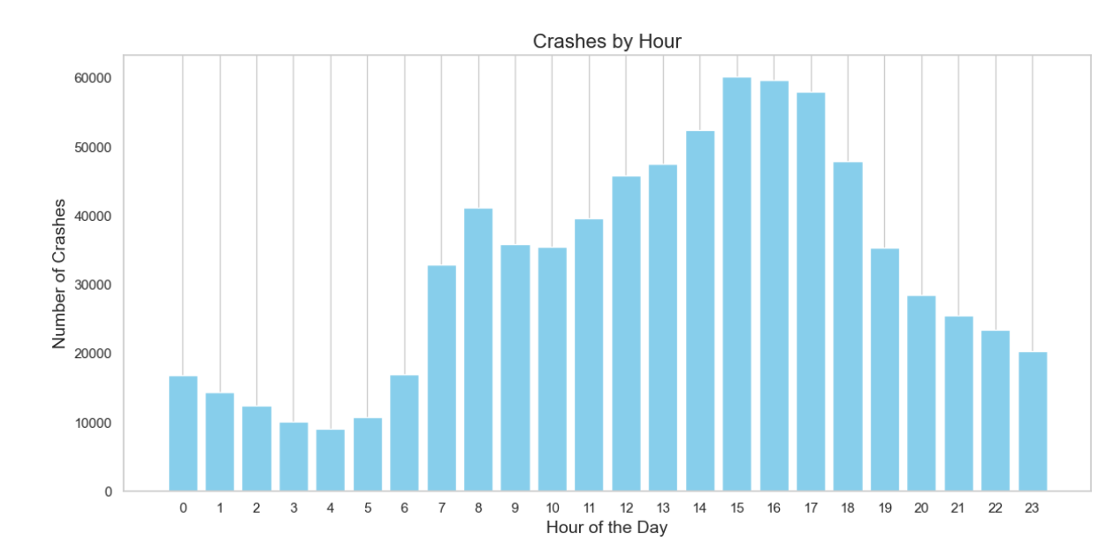
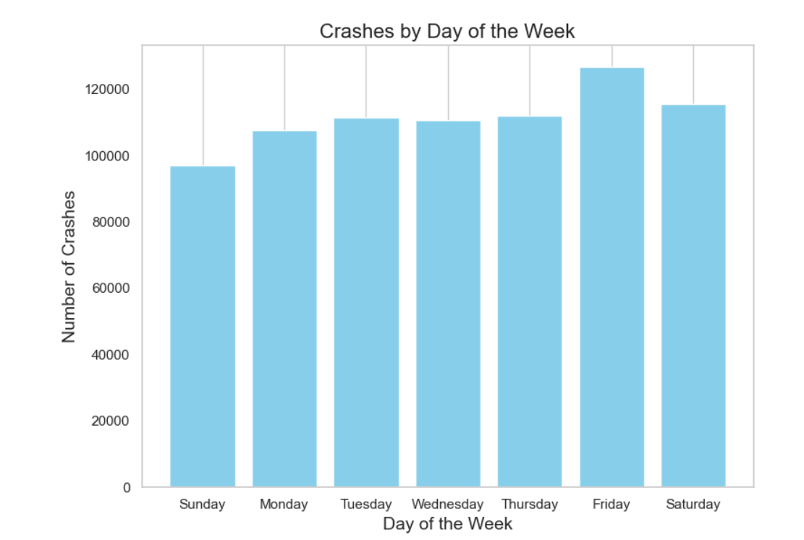
Exploratory Data Analysis
Temporal Analysis:
Crashes by Hour: "Traffic accidents peak during the late afternoon hours, particularly around 3-5 PM."
Crashes by Day of the Week: "Saturday sees the highest number of crashes compared to other days of the week."

Slide 8
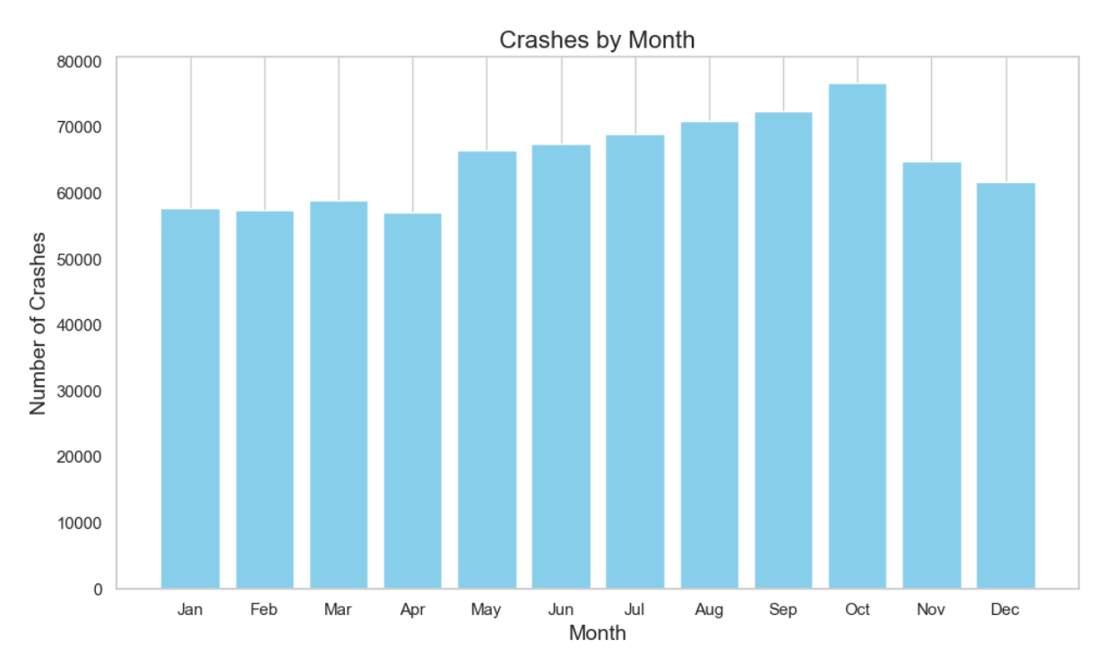
Crashes by Month: "October records the highest incidence of traffic crashes, with a steady increase in numbers from June."

Slide 9
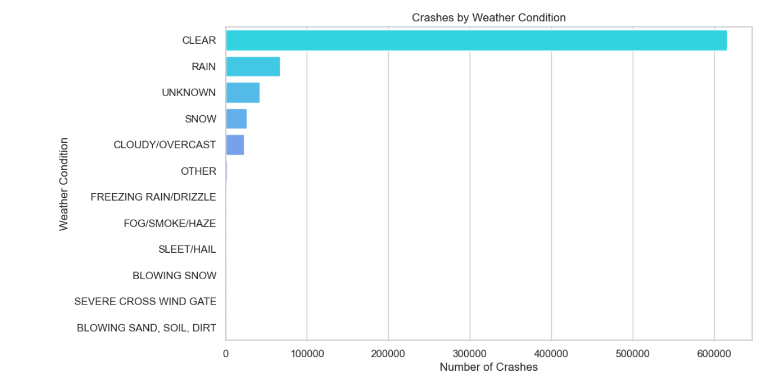
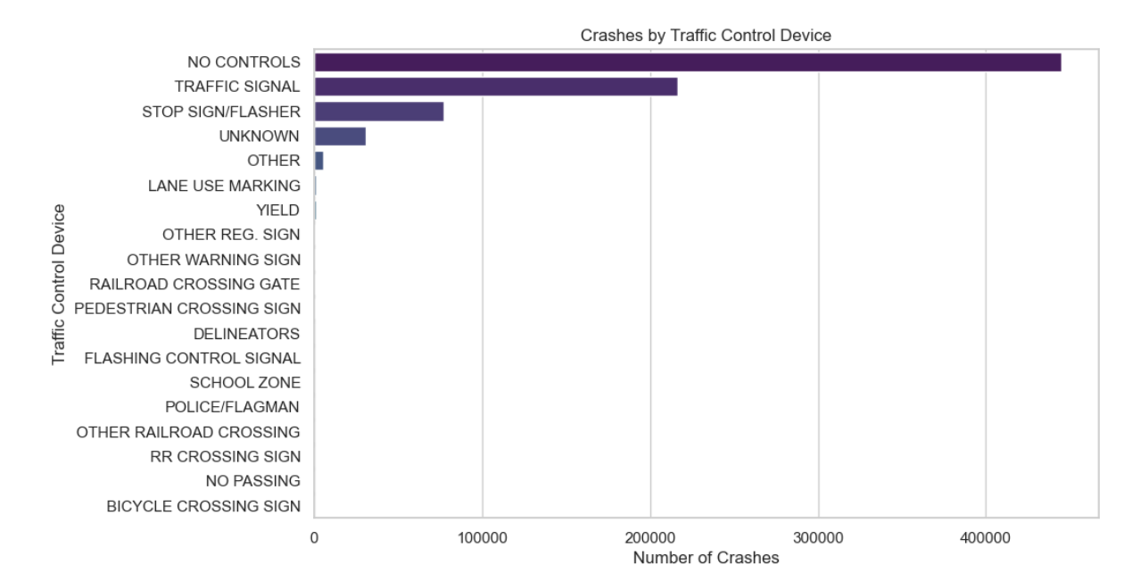
Categorical Analysis:
Crashes by Weather Condition: "Most crashes occur in clear weather conditions, with rain being the second most common weather during crashes.“
Crashes by Traffic Control Device: "Crashes are most likely to occur at locations with no traffic control devices in place.

Slide 10
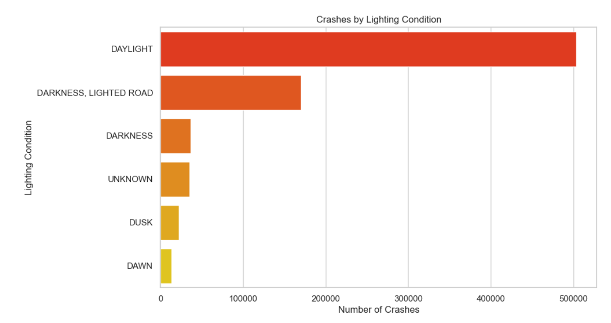
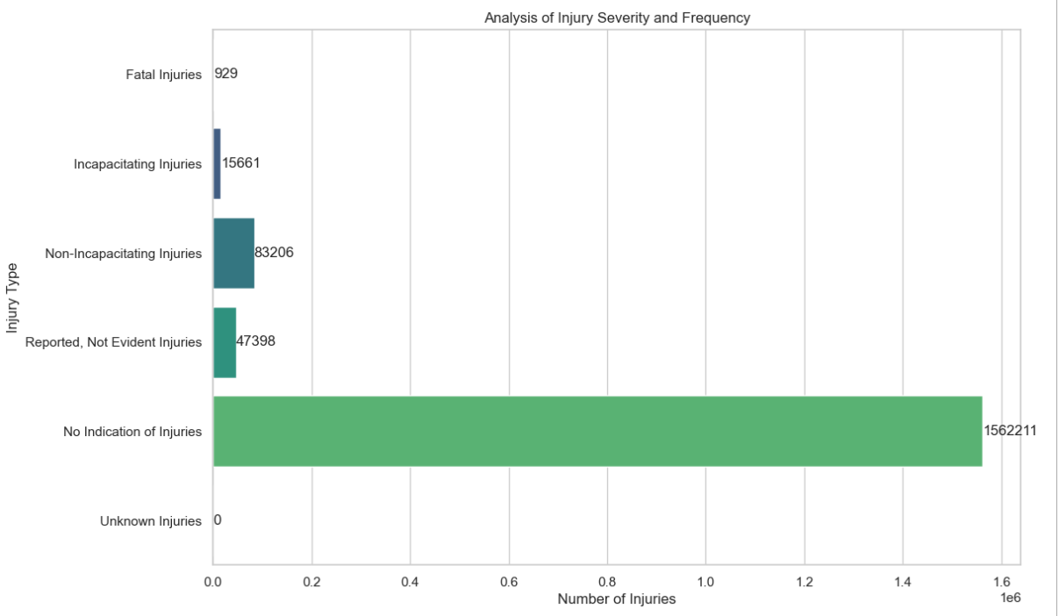
Crashes by Lighting Condition: "Daylight sees the highest number of crashes, followed by dark but lighted road conditions.“
Analysis of Injury Severity and Frequency: "The majority of crashes result in no injuries, with non-incapacitating injuries being the most common among crashes that do involve injuries."

Slide 11
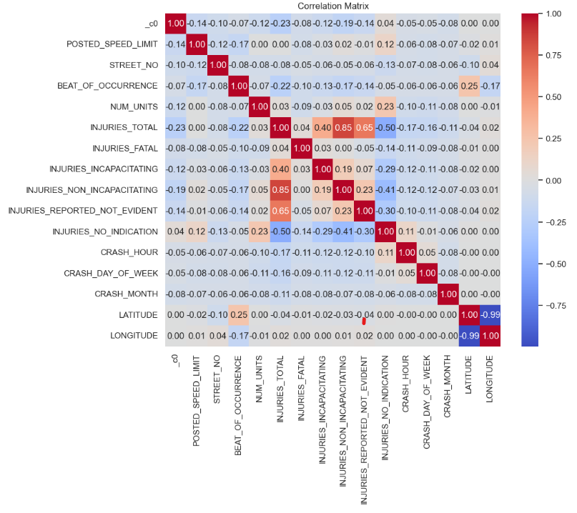
Correlation Analysis:
Total injuries have strong positive correlations with non-incapacitating injuries and reported, not evident injuries, indicating these are the most common injury types in crashes.
There is also a notable negative correlation between latitude and longitude, suggesting a geographical pattern in the distribution of crashes.“
The lack of significant correlation between crash hour, day of the week, and crash month with injury types suggests that the timing of crashes does not strongly influence the severity of injuries sustained.

Slide 12
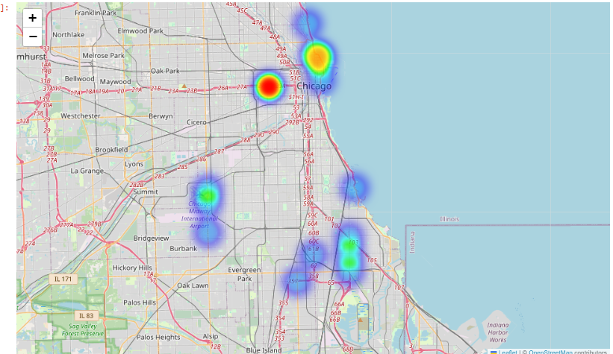
Geographical Analysis:
The image presents a heat map analysis over a geographical area of Chicago, highlighting the top ten locations with the highest counts of a specific dataset.
The heatmap reveals significant crash hotspots in the Chicago area, particularly concentrated in the city center and along major highways.
he highest frequency of crashes occurs at the latitude 41.8747 and longitude -87.6741 and crash _ count=5243, which could indicate a critical area for traffic safety interventions.

Slide 13
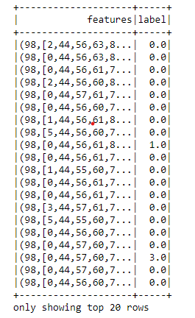
Feature Engineering
categorical variables have been one-hot encoded and assembled into a single feature vector.
The features column shows the Sparse Vector representation of the encoded features, features = 'POSTED_SPEED_LIMIT', 'WEATHER_CONDITION', 'LIGHTING_CONDITION', 'TRAFFIC_CONTROL_DEVICE', 'DEVICE_CONDITION','ROADWAY_SURFACE_COND','ROAD_DEFECT','CRASH_TYPE’
The label column contains numerical indices representing the target variable.
label = “INJURY_SEVERITY”

Slide 14
Machine Learning Algorithms Used
Since this is a classification problem, we have used various classification algorithms which are:
Random Forest Classifier
Logistic Regression Classifier
Gradient Boosting Classifier
Linear SVC classifier
Decision Tree Classifier
Target : ‘INJURY_SEVERITY’
Features : 'POSTED_SPEED_LIMIT', 'WEATHER_CONDITION', 'LIGHTING_CONDITION', 'TRAFFIC_CONTROL_DEVICE', 'DEVICE_CONDITION','ROADWAY_SURFACE_COND','ROAD_DEFECT','CRASH_TYPE’

Slide 15





Random Forest Classifier
Logistic Regression Classifier
Linear SVC classifier
Decision Tree Classifier
Gradient Boosting Classifier

Slide 16
Conclusion
In this project, we have analyzed traffic crash data and employed machine learning techniques to predict the primary type of traffic incidents severity. We have extracted valuable insights that can aid traffic safety authorities and law enforcement in devising targeted interventions and policies. Ultimately, this project highlights the capacity of machine learning to assist in the analysis and prediction of traffic crashes injuries severity, contributing to enhanced road safety measures.

Slide 17
REFERENCES
Data source- https://data.cityofchicago.org/Transportation/Traffic-Crashes-Crashes/85ca-t3if

Slide 18
THANKYOU

